Slide 1
Operating Systems Module-1

Slide 2
What is an Operating System?
A program that acts as an intermediary between a user of a computer and the computer hardware.
Operating system goals:
Execute user programs and make solving user problems easier.
Make the computer system convenient to use.
Use the computer hardware in an efficient manner.

Slide 3
Definition
A computer program that acts as an interface between the user and computer hardware and controls and manages the overall resources of the computer system.

Slide 4
A few questions…..
Have you written any programs?
Is it platform-dependent or platform-independent?
Where do you execute your programs?
Did you use any compilers?
Can I copy and execute my compiled code from my desktop to laptop?
Does the mother board contain only one component?
If not, who is going to manage all the components?
What is abstraction and interface?

Slide 5
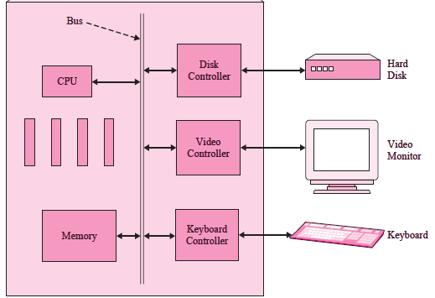
Hardware: A very simplistic view of a small personal computer

Slide 6
Hardware resources of a computer:
CPUs (processors)
Main memory and caches,
Secondary storage,
I/O devices at the lowest level,
Network access
Who is going to manage these resources?
A User or Software?
Software – Operating Systems
Why to manage these resources?

Slide 7
Operating System
The OS is a collection of one or more software modules that manages and controls the resources of a computer or other computing or electronic device, and gives users and programs an interface to utilize these resources. The managed resources include memory, processor, files, input or output devices, and so on.
Responsibilities/ Services
Memory management
Device management
Processor management
Security
Error detection
Job accounting
File management

Slide 8
Operating System Services/ Functionality
One set of operating-system services provides functions that are helpful to the user:
User interface - Almost all operating systems have a user interface (UI)
Varies between Command-Line (CLI), Graphics User Interface (GUI)
Program execution - The system must be able to load a program into memory and to run that program, end execution, either normally or abnormally (indicating error)
I/O operations - A running program may require I/O, which may involve a file or an I/O device.
File-system manipulation - The file system is of particular interest. Obviously, programs need to read and write files and directories, create and delete them, search them, list file Information, permission management.

Slide 9
Operating System Services (Cont.)
One set of operating-system services provides functions that are helpful to the user (Cont):
Communications – Processes may exchange information, on the same computer or between computers over a network
Communications may be via shared memory or through message passing (packets moved by the OS)
Error detection – OS needs to be constantly aware of possible errors
May occur in the CPU and memory hardware, in I/O devices, in user program
For each type of error, OS should take the appropriate action to ensure correct and consistent computing
Debugging facilities can greatly enhance the user’s and programmer’s abilities to efficiently use the system

Slide 10
Operating System Services
Another set of OS functions exists for ensuring the efficient operation of the system itself via resource sharing
Resource allocation - When multiple users or multiple jobs running concurrently, resources must be allocated to each of them
Many types of resources - Some (such as CPU cycles,mainmemory, and file storage) may have special allocation code, others (such as I/O devices) may have general request and release code.
Accounting - To keep track of which users use how much and what kinds of computer resources
Protection and security - The owners of information stored in a multiuser or networked computer system may want to control use of that information, concurrent processes should not interfere with each other
Protection involves ensuring that all access to system resources is controlled
Security of the system from outsiders requires user authentication, extends to defending external I/O devices from invalid access attempts
If a system is to be protected and secure, precautions must be instituted throughout it. A chain is only as strong as its weakest link.

Slide 11
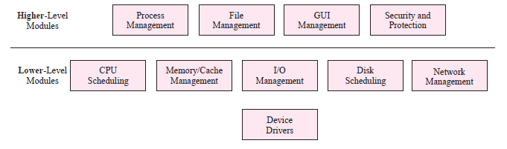
Major OS modules

Slide 12
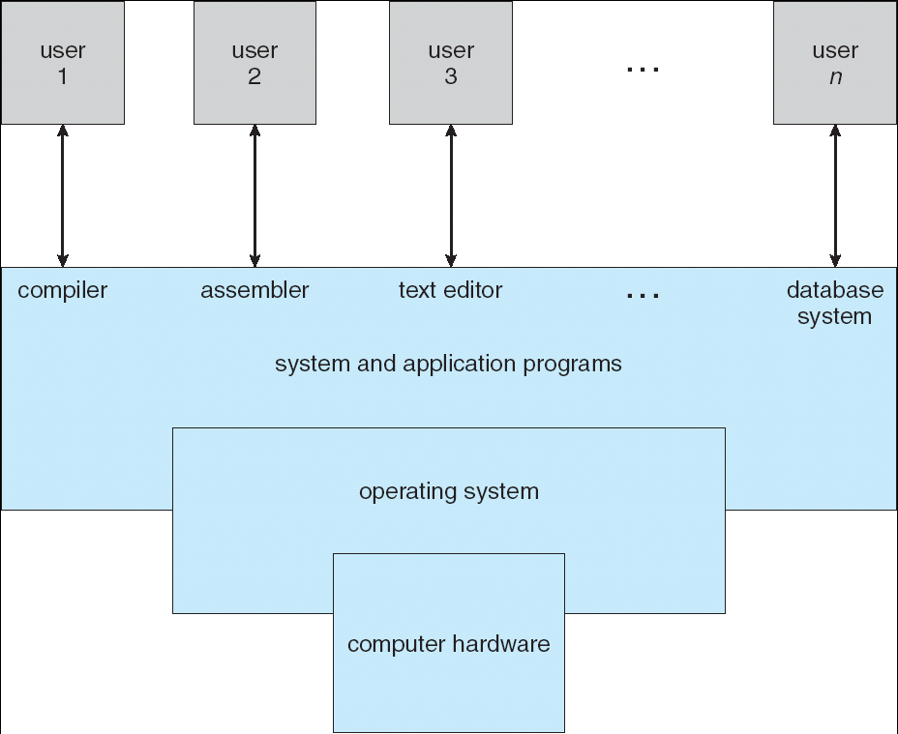
Four Components of a Computer System

Slide 13
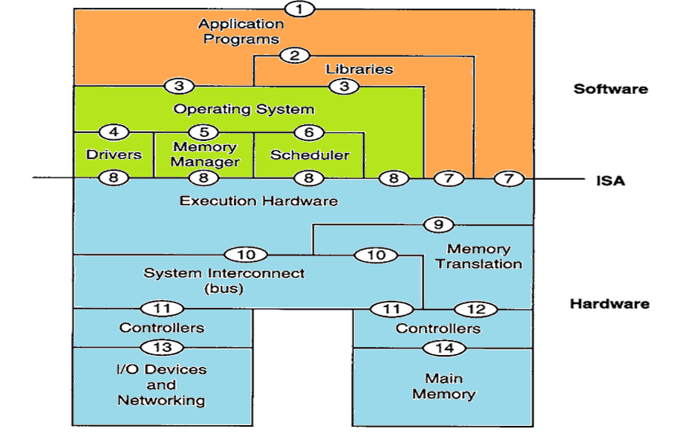
Computer System Architecture: Abstraction and Interfaces
Notes:
ISA → Instruction Set Architecture

Slide 14
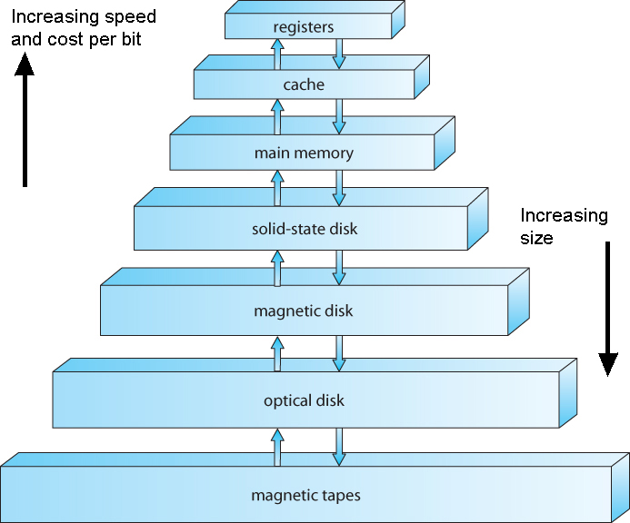
Storage Structure

Slide 15
Memory – Array of words
Word - Largest size of data that can be transferred in and out of the memory.
Interaction occurs through LOAD and STORE
Main Memory – rewritable memory (RAM)
Implemented in a semiconductor technology called DRAM
Volatile, very fast and expensive

Slide 16
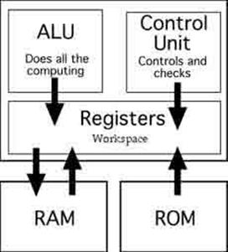
Registers:
Very expensive and very fast.

Slide 17
Storage contd..
Secondary memory
Electronic disk
Magnetic disk
Optical disk
Magnetic tapes
Cache Memory
Random access memory (RAM) that a computer microprocessor can access more quickly than it can access regular RAM.
Most frequently used instructions are stored in the cache.

Slide 18
OS Abstraction
The operating system provides a layer of abstraction between the user and the bare machine. Users and applications do not see the hardware directly, but view it through the operating system.
This abstraction can be used to hide certain hardware details from users and applications. Thus, changes in the hardware are not seen by the user (even though the OS must accommodate them).
This is particularly advantageous for vendors that want offer a consistent OS interface across an entire line of hardware platforms.
Another way that abstraction can be used is to make related devices appear the same from the user point of view. For example, hard disks, floppy disks, CD-ROMs, and even tape are all very different media, but in many operating systems they appear the same to the user.
Unix, and increasingly Windows NT, take this abstraction even further. From a user and application programmer standpoint, Unix is Unix regardless of the CPU make and model.

Slide 19
Abstraction
Hide the implementation details of a component
Freedom to modify the implementation without affecting other underlying modules
Ex: int add(int a, int b) {
return a + b; // Implementation details
}
Interface
To hide the details of lower level components
To enable the communication / data passing between the components without knowing details of their implementation
Ex: printf(“%d, %d”, add(5,10), add(10,10))
Abstraction
Component -1
Interface
Abstraction
Component -2
Take away:
If you introduce an interface,
you want to hide the implementation details below it

Slide 20
Major OS modules
Each of the responsibilities is implemented as separate
Modules (abstraction) which are combined together through
appropriate interfaces to formulate an Operating System
software

Slide 21
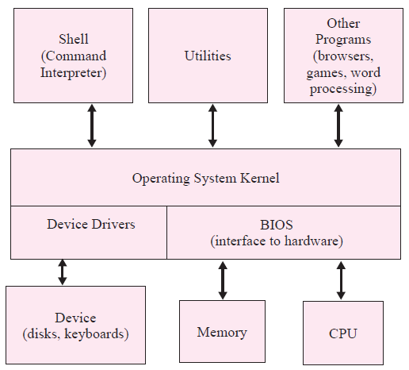
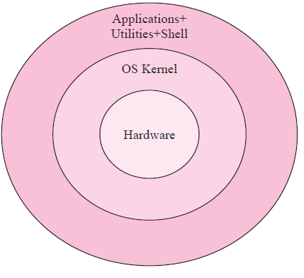
OS in relationship to hardware
Shell: programs that are not part of the OS core (or kernel), but work closely with the kernel to provide ease of use or access to system information. A shell or command interpreter is an example of a utility
Service: Services are functions that the OS kernel provides to users, mostly through
APIs via OS calls. Ex: file manipulation services (create, read, copy), memory allocation services (get, free)
Kernel: refers to that part of the OS that implements basic functionality and is always present in memory
Layered or Levels approach

Slide 22
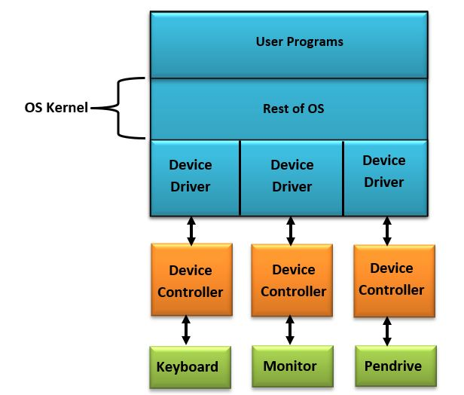
Role of device, device controller and device driver
Device (Hardware)
A device is a piece of hardware connected to the main computer system hardware
Hard disks, DVDs, and video monitors
Device Controller (Hardware)
Usually, every device has a special electronic hardware interface, called a device controller, which helps connect a device or a group of similar devices to a computer system through a bus.
hard disk controllers and video monitor controllers
converts a serial bit stream to block of bytes and perform error correction as required
Record and save the data
Device driver (Software)
A device driver is a software routine that is part of the OS, and is used to communicate with and control a device through its device controller.
works as a translator between the hardware device and the application or the operating system that uses it

Slide 23
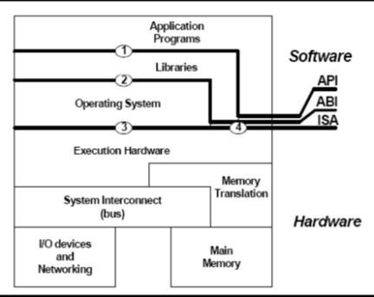
Notes:
API → Application Programming Interface
ABI → Application Binary Interface
ISA → Industry Standard Architecture

Slide 24
What is the role of the OS?
Role #1: abstract resources
What is a resource?
Anything valuable (e.g., CPU, memory, disk)
Advantages of standard library
Allow applications to reuse common facilities
Make different devices look the same
Provide higher-level abstractions

Slide 25
What is the role of the OS?
Role #2: Resource coordinator (I.e., manager)
Advantages of resource coordinator
Virtualize resources so multiple users or applications can share
Protect applications from one another
Provide efficient and fair access to resources

Slide 26
Desirable qualities of an OS
Certain OS parts those handle the user and application program interaction should never be exposed to the users
Abstraction and Interface
OSs should provide new features and be easier to work with.
Updated periodically
OSs must provide support for old features
Backward compatibility
OSs must be able to connect, adapt and handle new devices that are not yet available and not even have been thought of when the OS was created
Extendable

Slide 27
User and System view of an OS
User View: How users or programs utilize the OS?
Type of users
Application Users / End Users
Application Programmers
System View: How the OS software actually does the required action?
how it gets keystrokes, separates out special ones like shift, and makes them available to the user or program.
Type of Users
System programmers
System Administrators

Slide 28
User View – Types of Users
Application User / End User
people who use (or run) application or system programs
expect a quick, reliable response (to keystrokes or mouse movement
Application Programmers
people who write application programs
system calls or an API (application program interface)
System View –Types of Users
Systems Programmers
these are the people who write software—either programs or components—that is closely tied to the OS.
have a detailed understanding of the internal functioning of the OS
A utility that shows the status of the computer’s network connection or an installable driver for a piece of hardware are examples of systems programs.
System Administrators
people who manage computer facilities, responsible for installing and upgrading the OS, as well as other systems programs and utilities

Slide 29
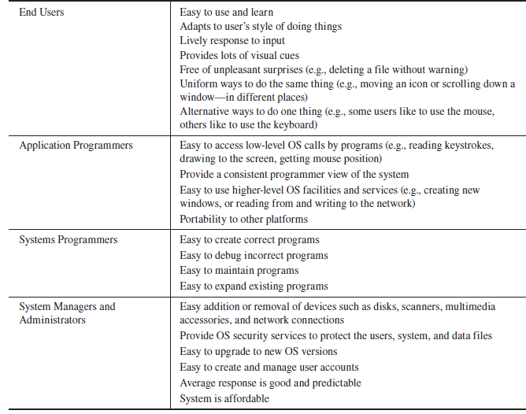

Slide 30
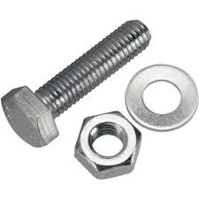
Application User
Application Programmers
System Programmers
System Administrators

Slide 31
Example : Moving a mouse (and mouse cursor)
When the pointing device is moved,
it generates a hardware event called an interrupt which the OS handles.
OS notes the movements of the mouse in terms of some hardware-specific units:
System view: Which application gets this mouse movement if there are multiple open windows?
The mouse movements may need to be queued up if there are multiple movements before the application retrieves them.
movements may even be lost if the OS is busy doing other things
Low-level System view: actual software reading the mouse movements as number of pulses which is part of the OS, and is called a mouse device driver
High-level system view: device driver reads the low-level mouse movement information and another part of the OS interprets it so that it can be converted into a higher-level system view,
How is the mouse movements info presented to the application programmer?
Application programmers’ view: How do I get the mouse movement information in order to use it and display it in my application?
User view: user’s view is that the cursor will smoothly move on the screen and that as the mouse moves greater distances faster, the screen movement will appear faster too.

Slide 32
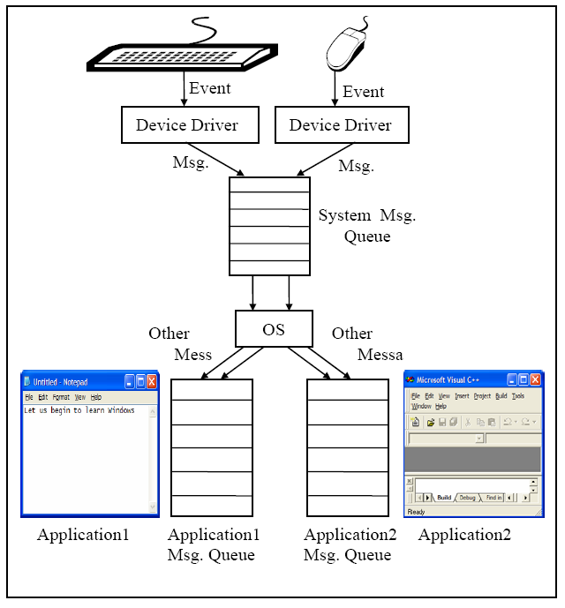
System View
Notes:
32
III IT 2008-2009
CS1233 VP

Slide 33
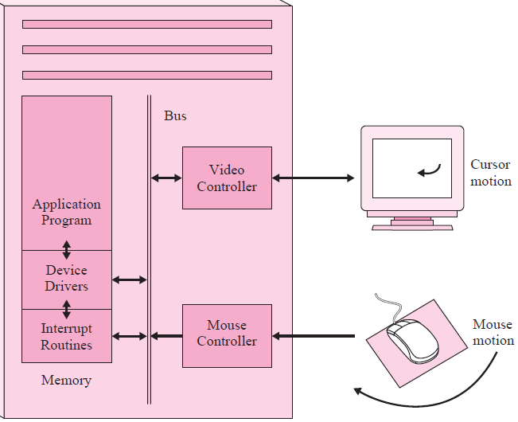
Application programmer’s View
User View
High-level System View
Low-level System View

Slide 34
Example : Files
End user’s view: File names
Can file names contain spaces? How long can they be? Are upper and lowercase letters allowed? Are they treated as different or the same characters? How about non-English characters or punctuation?
Application programmer’s view: the file system is a frequently used, critical part of the system
commands for creating a new file, using an existing file, reading or appending data to a file, and other file operations.
System view: file system is so large it is usually divided into subparts:
file naming and name manipulation (directory services),
file services such as locating and mapping a file name to its data (file allocation and storage),
trying to keep parts of open files in main memory to speed up access to its data (file buffering and caching), and
the actual management of the storage devices (disk scheduling).

Slide 35
History of the OS
Two distinct phases of history
Phase 1: Computers are expensive
Goal: Use computer’s time efficiently
Maximize throughput (I.e., jobs per second)
Maximize utilization (I.e., percentage busy)
Phase 2: Computers are inexpensive
Goal: Use people’s time efficiently
Minimize response time

Slide 36
Single-tasking OS
OS runs a single process at a time
Example: CP/M and MS-DOS
Handling I/O, starting and terminating programs
Fairly simple Memory management
no need for CPU scheduling
Supports batch job
have no live user so rapid response is not a requirement
less context switching is needed and more time is spent on productive computing

Slide 37
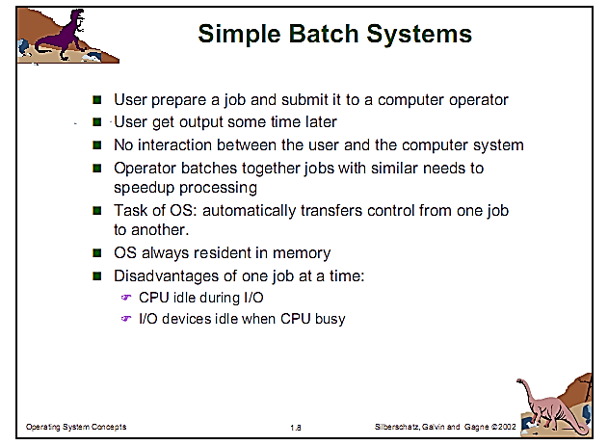
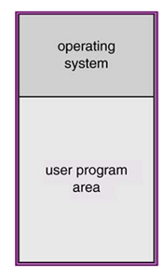
Single-user single-tasking Batch processing system

Slide 38
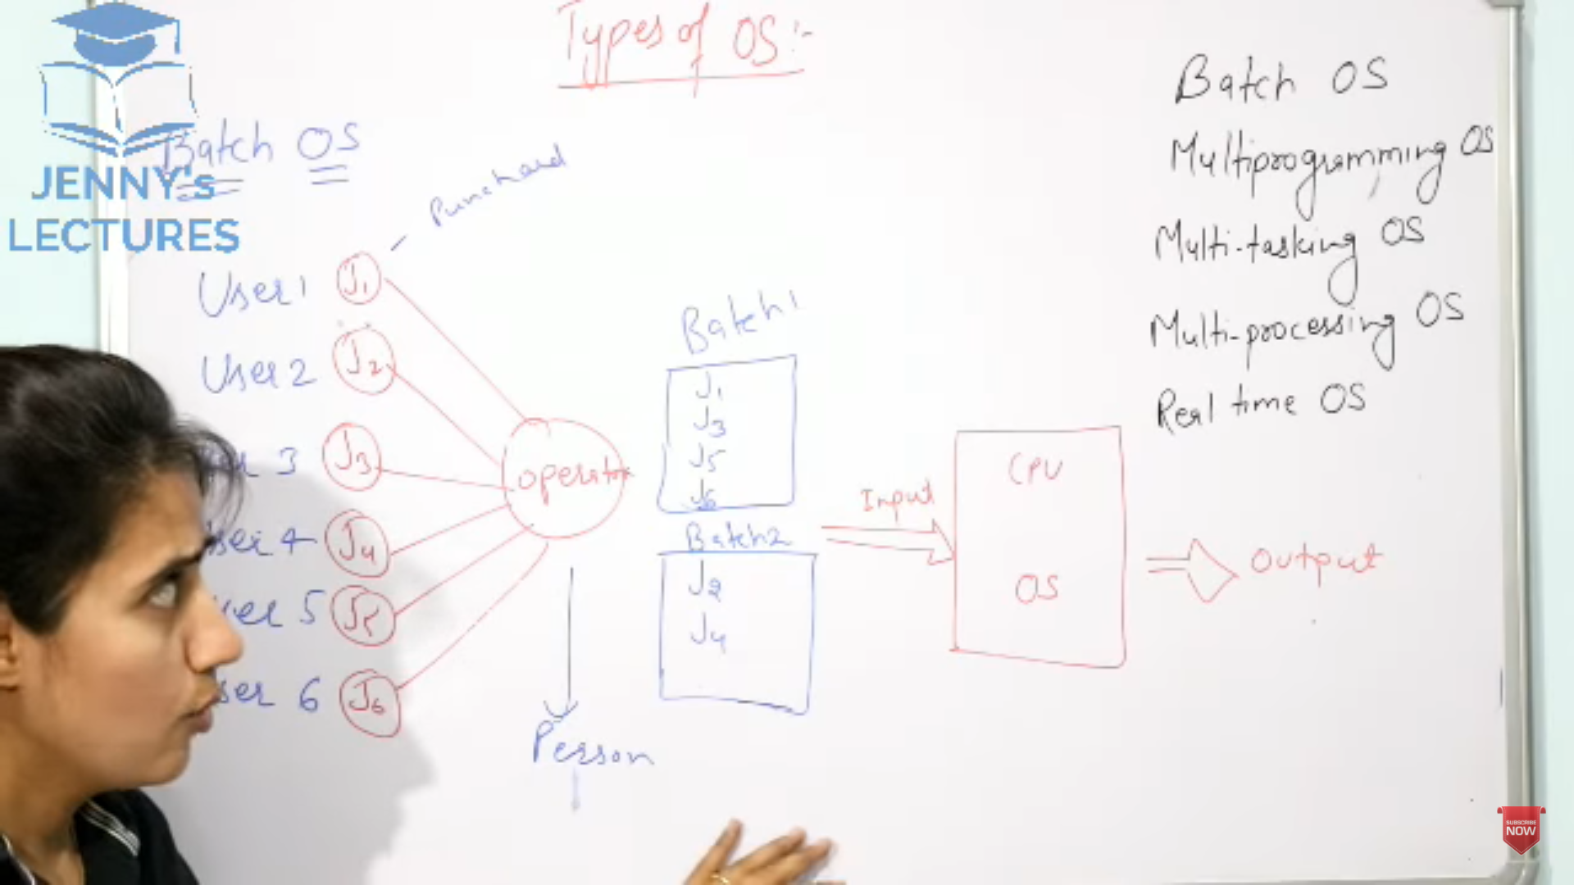

Slide 39
Multitasking or Multiprogramming OS
OS will control multiple processes running concurrently
CPU scheduling component is used to choose which of the ready to run processes to run next
The CPU can switch to run another process while I/O is performed.
Context Switching: Changing from one running process to run another process is known as context switching
entire CPU state must be saved on process-1’s Process Control Block (PCB), execute the process-2 for a stipulated period of time, save the CPU state of process-2 in PCB of 2, switch back to process-1 and resume from stored CPU state by loading PCB-1
Supports both interactive and batch jobs
Interactive jobs are processes that handle a user interacting directly with the computer through mouse, keyboard, video monitor display, and other interactive I/O devices whereas batch jobs do not support user interaction with computers.
Advantages
Improve processor utilization by keeping the CPU busy while I/O is performed
When a process waiting for I/O, the CPU will execute other process

Slide 40
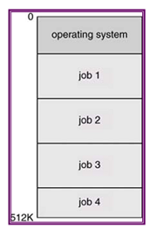
Multiprogramming needed for efficiency
Single program cannot keep CPU and I/O devices busy at all times
Multiprogramming organizes jobs (code and data) so CPU always has one to execute
A subset of total jobs in system is kept in memory
One job selected and run via job scheduling
When it has to wait (for I/O for example), OS switches to another job

Slide 41
Multi-programming systems demand
Job scheduling
To decide which jobs in a job pool should be brought into memory
Memory management
Allocate memory to many jobs
CPU scheduling
Choose the jobs in memory that are in ready to run state
Allocation of devices
If more than one job is competing for resources
Jobs that are running concurrently should not affect the other.

Slide 42
Timesharing Systems
(multitasking) is logical extension in which CPU switches jobs so frequently that users can interact with each job while it is running, creating interactive computing
Response time should be < 1 second
Each user has at least one program executing in memory i.e. process
If several jobs ready to run at the same time need CPU scheduling to decide the job to be executed
If processes don’t fit in memory, swapping moves them in and out to run
Virtual memory allows execution of processes not completely in memory

Slide 43
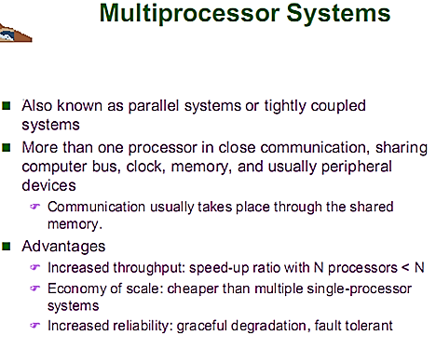
Multiprocessor system

Slide 44
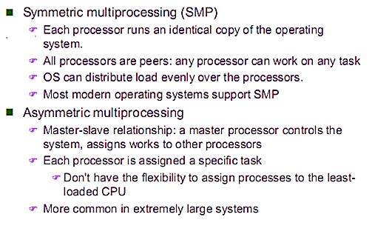
Multiprocessor system

Slide 45
Clustered System
Clustered systems are typically constructed by combining multiple computers into a single system to perform a computational task distributed across the cluster.
Multiprocessor systems on the other hand could be a single physical entity comprising of multiple CPUs.
A clustered system is less tightly coupled than a multiprocessor system.
Clustered systems communicate using messages, while processors in a multiprocessor system could communicate using shared memory.
In order for two machines to provide a highly available service, the state on the two machines should be replicated and should be consistently updated.
When one of the machines fail, the other could then take-over the functionality of the failed machine.

Slide 46
KINDS OF OS & PROPERTIES
Properties of the following types of operating systems:
a. Batch
b. Interactive
c. Time sharing
d. Real time
e. Network
f. Parallel
g. Distributed
h. Clustered
i. Handheld

Slide 47
KINDS OF OS & PROPERTIES
a. Batch. Jobs with similar needs are batched together and run through the computer as a group by an operator or automatic job sequencer. Performance is increased by attempting to keep CPU and I/O devices busy at all times through buffering, off-line operation, spooling, and multiprogramming. Batch is good for executing large jobs that need little interaction; it can be submitted and picked up later.
b. Interactive. This system is composed of many short transactions where the results of the next transaction may be unpredictable. Response time needs to be short (seconds) since the user submits and waits for the result.
c. Time sharing. This systems uses CPU scheduling and multiprogramming to provide economical interactive use of a system. The CPU switches rapidly from one user to another. Instead of having a job defined by spooled card images, each program reads its next control card from the terminal, and output is normally printed immediately to the screen.

Slide 48
KINDS OF OS & PROPERTIES
d. Real time. Often used in a dedicated application, this system reads information from sensors and must respond within a fixed amount of time to ensure correct performance.
e. Network. Provides operating system features across a network such as file sharing.
f. SMP. Used in systems where there are multiple CPU’s each running the same copy of the operating system. Communication takes place across the system bus.
g. Distributed. This system distributes computation among several physical processors. The processors do not share memory or a clock. Instead, each processor has its own local memory. They communicate with each other through various communication lines, such as a high-speed bus or local area network.
h. Clustered. A clustered system combines multiple computers into a single system to perform computational task distributed across the cluster.
i. Handheld. A small computer system that performs simple tasks such as calendars, email, and web browsing. Handheld systems differ from traditional desktop systems with smaller memory and display screens and slower processors.

Slide 49
ARCHITECTURAL APPROACHES TO BUILDING AN OS 1. Monolithic single-kernel OS approach 2. Layered OS approach 3. Modular approach 4.Microkernel OS approach

Slide 50
Monolithic single-kernel OS approach
written as a single program ( no modules at all)
kernel or monolithic kernel
Disadvantages
As monolithic kernel size grew if more and more functionalities are added, percentage of main memory occupied by the OS is too large.
Lead to had more bugs,
Difficult to maintain,
Difficult to add features or to fix bugs
Solution
develop OSs based on a more modular, layered design

Slide 51
Layered OS approach
modular OS approach that was developed was a layered architecture.
OS is divided into modules that were limited to a specific function such as processor scheduling or memory management.
The modules were grouped into layers of increasing abstraction
each layer provides a more abstract view of the system and relies on the services of the layers below it.
The layered approach would hide the peculiarities and details of handling hardware devices, and provide a common abstract view to the rest of the OS.
Thus, when new devices entered the marketplace, new device drivers could be added to the kernel without drastically affecting the other OS modules, which provide memory management, processor scheduling, and the file system interface.
Disadvantage/Critic:
OS design should return to a minimum amount of code in the kernel
Solution
Microkernel approach

Slide 52
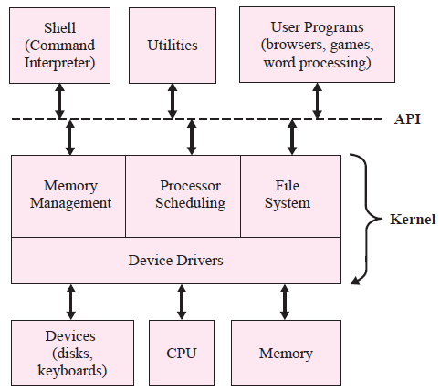
Different Variations
Allow modules at layer n to call only the modules in the next lower layer n-1
allow modules at layer n to call modules at any of the lower layers ( n-1, n-2, and so on).
allow level n modules to interact with other level n modules

Slide 53
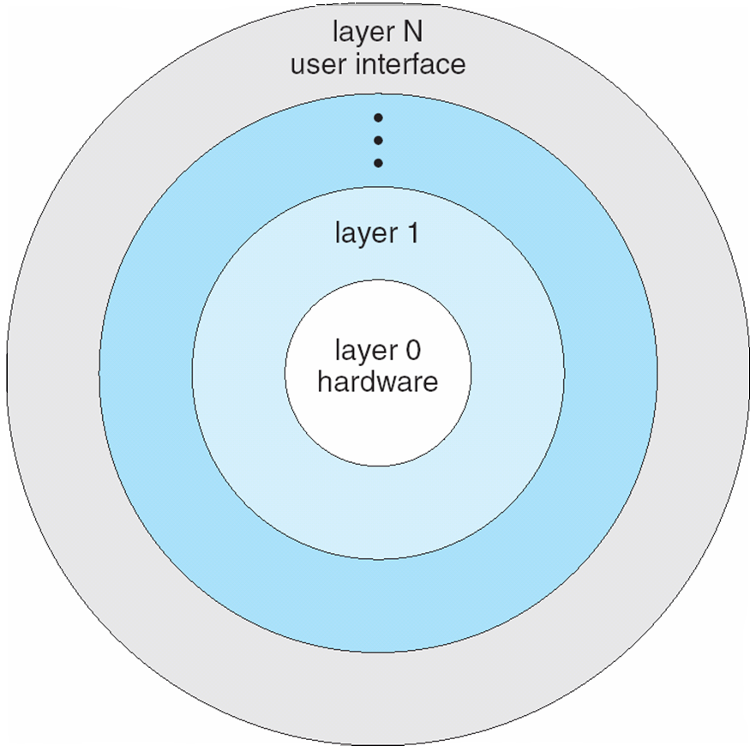
Layered Approach
The operating system is divided into a number of layers (levels), each built on top of lower layers. The bottom layer (layer 0), is the hardware; the highest (layer N) is the user interface.
With modularity, layers are selected such that each uses functions (operations) and services of only lower-level layers

Slide 54
Modules
Many modern operating systems implement loadable kernel modules
Uses object-oriented approach
Each core component is separate
Each talks to the others over known interfaces
Each is loadable as needed within the kernel
Overall, similar to layers but more flexible
Linux, Solaris, etc

Slide 55
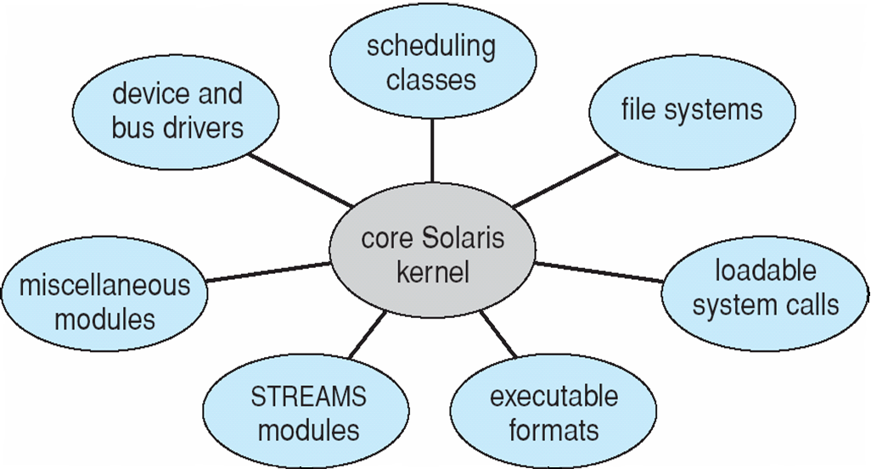
Solaris Modular Approach

Slide 56
Microkernel OS approach
More robust – As the amount of code that is running in supervisor mode is smaller
easier to inspect for flaws
easier to port a small microkernel to a new platform
Only basic functionality, usually the interfaces to the various types of device drivers, is included in the microkernel
code that must run in supervisor mode because it actually uses privileged resources such as protected instructions or accesses memory not in the kernel space
Code running in protected mode literally can do anything, so an error in this code can do more damage than code running in user mode
Remainder of the OS functions are still part of the resident OS, but they run in user mode rather than protected mode
Make use of interrupts to make the necessary calls from the user mode portions of the OS to the supervisor mode portions.
Disadvantage/Critics:
Makes a microkernel OS run more slowly due to context switching and not yet resolved

Slide 57
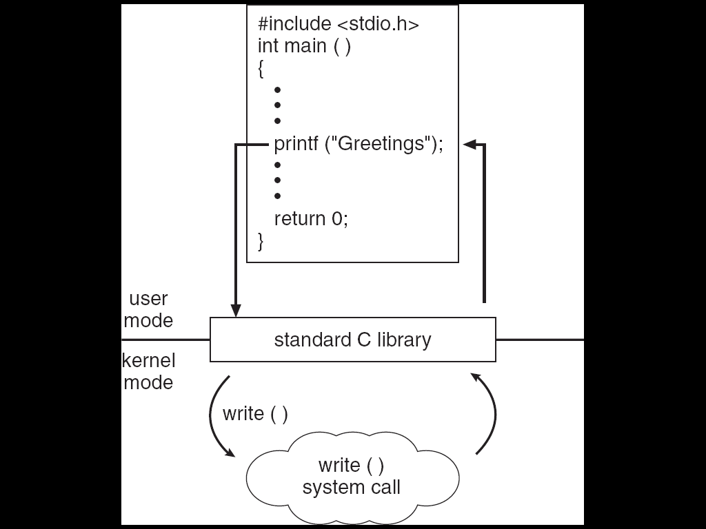
Standard C Library Example
C program invoking printf() library call, which calls write() system call

Slide 58
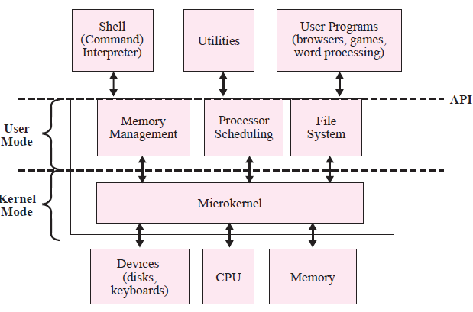

Slide 59
OS Design Issues
Minimalist
only those things that really must go into the kernel (or microkernel) are included in the OS.
Other components may be added into library routines or as “user” programs but not written by the user.
Claims:
Load when it is really needed
Write and integrate new components
Easy to design
Elegant or cleaner
Maximalist
philosophy—to put most of the commonly used services in the OS
Claims:
Consistent look and feel

